Slide 1
Tableau Reader – Installation
Application is free to download and install
http://www.tableausoftware.com/products/reader
Before downloading, check to see if your machine is 32-bit or 64-bit
Check your machine’s System Properties
Start (lower-left button) > Computer > System Properties
Look at “System Type” under “System” category

Slide 2
Tableau Reader – Installation
Click on “Download Reader Now”
In centre of webpage (with orange background)
Select appropriate version, if necessary (34-bit or 64-bit)
Run the application download

Slide 3
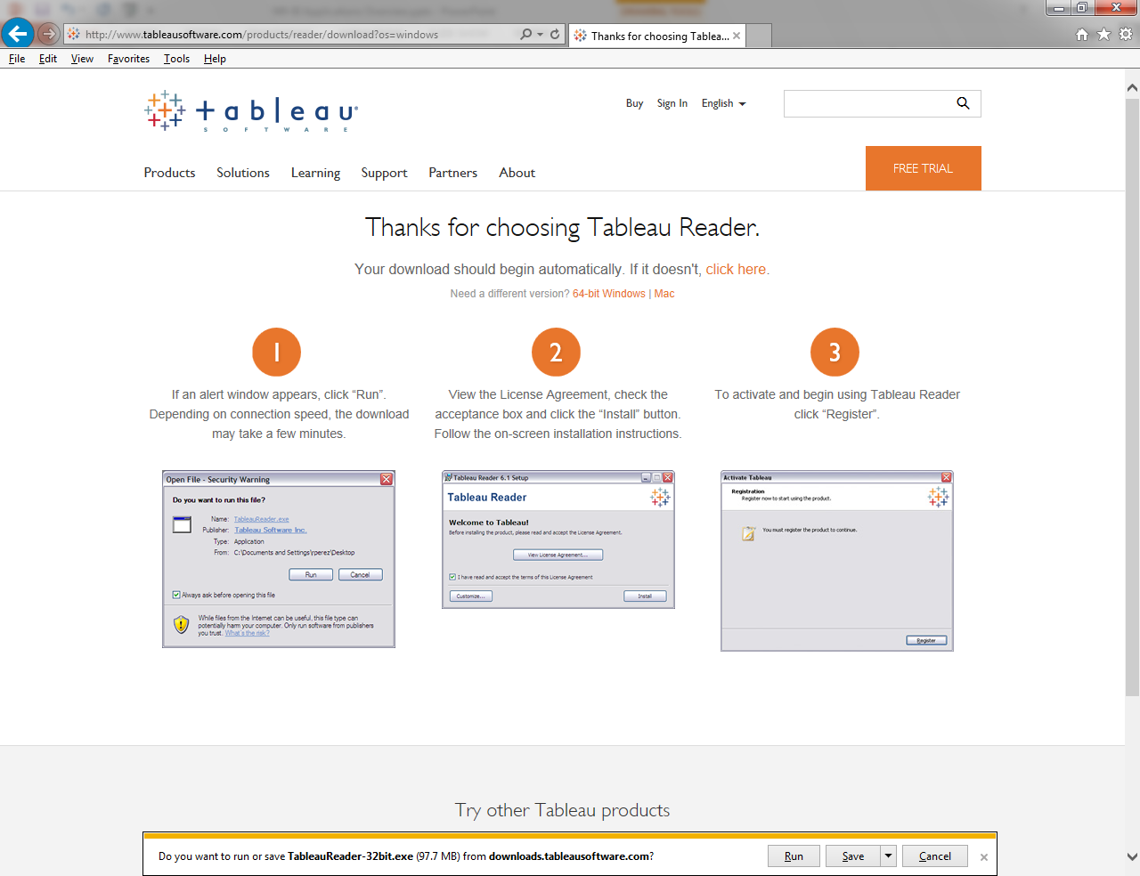
Tableau Reader – Installation

Slide 4
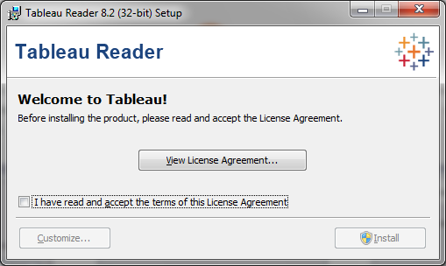
Tableau Reader – Installation
Accept the License Agreement and click on Install (you may need to register)
Click on samples to view interactive dashboards

Slide 5
Tableau Desktop - Installation
Application free to download and install
good for one year (must enter Activation Key)
http://www.tableausoftware.com/products/desktop
Click on “TRY IT FREE”
Select appropriate version (23-bit or 64-bit), if necessary
Run the application download

Slide 6
Tableau Desktop - Installation
Accept the License Agreement and click on Install (you will be required to enter your Activation Key number and register)
Activation Key will be supplied by professor
Click on samples to view visualizations

Slide 7
Tableau Desktop – Online Tutorials
To become familiar with Tableau, view online training sessions from Tableau
The sessions are called “On-Demand” training and can be accessed by clicking here
Select the sessions from the “Getting Started” category and continue through to the “Calculations and Statistics” category

